Slide 1
Matrix Updates
Notes:
INTERNAL

Slide 2
Table of Contents
New Lookup under Showing Instructions
3

Slide 3
Addition of ‘Lock Box Electronic – CBS Code Required’ field to Showing Instructions
Why are we added this lookup?
Property Types/ Forms Affected
Residential Input / Search
Commercial Input / Search
Income Input / Search
Rental Input / Search
Vacant Land Input / Search
Supra Lockboxes have a CBS (“Call Before Showing”) code feature. Currently “Call Before Showing” is a lookup in Showing Instructions. To prevent confusion from our agents as to whether the “Call Before Showing” lookup meant to provide a courtesy call or if a Call Before Showing code is needed, our Board of Directors voted to add the clarifying lookup value.
Processes and Listings affected
No Listings Affected
No change to User Experience

Slide 4
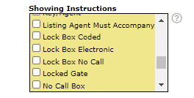
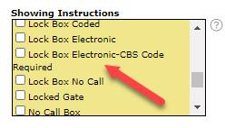
Addition of Lookup to Showing Instructions (Continued)
Previously
Currently

Slide 5
For Support:
EMAIL
support@StellarMLS.com
CALL
800-686-7451

